Slide 1
Modeling and Simulation for Fast Food Supply Chain Management
Lu Lin, Columbus State University
Computer Science
lin_lu@columbusstate.edu
INSTRUCTOR: Dr. Anastasia Angelopoulou

Slide 2
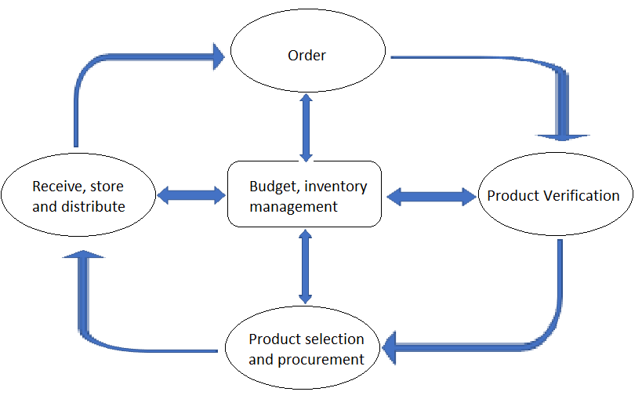
Typical Supply Chain Management (SCM) process
The SCM in fast food industry can be divided into a series of cycles:
Order is triggered when the inventory reaches a certain low point as it is consumed.
Verify the product availability.
Select the appropriate product based on availability, cost, quantity, delivery date, etc.
Receive, store, and distribute.
Budge and inventory management.
Figure 1. A Typical Fast Food SCM Process

Slide 3
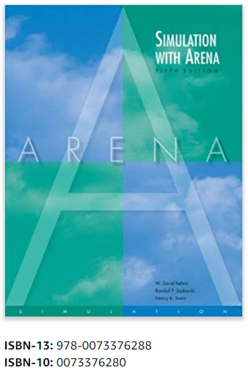
Modeling and Simulation (MS) of SCM in fast food industry
ARENA software is used to build models and simulate a SCM case study.
MS represents a food supply chain system and examine its operations using different possible scenarios and conditions.
MS is powerful to support SCM decision making as it explores SCM optimization, cost control, risk management, etc.

Slide 4
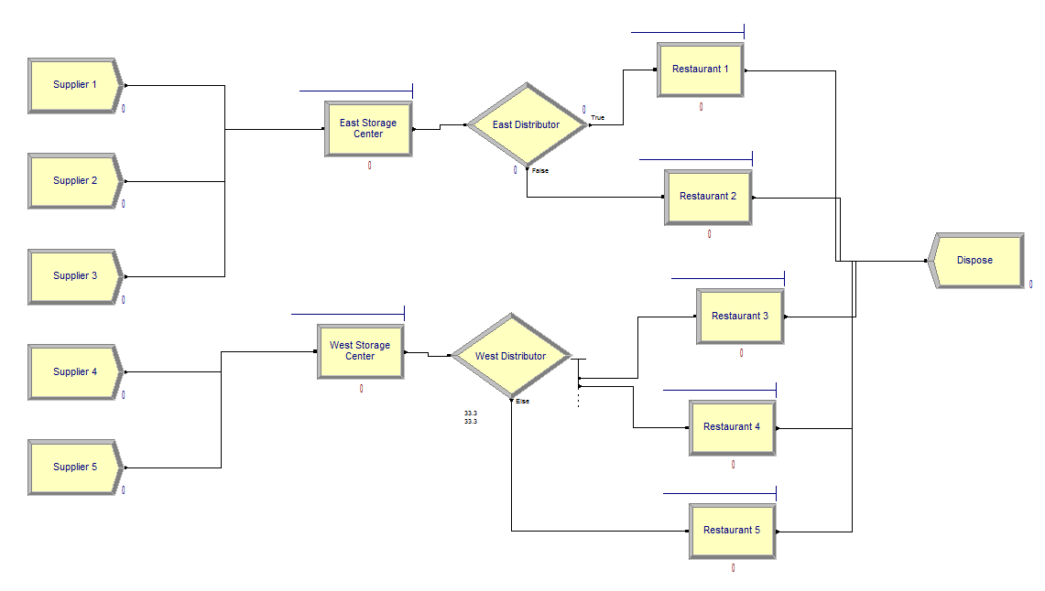
Case Study Background
The case is the supply chain (SC) of a local fast food chain store. Five food suppliers serve as create units to produce “food” as the main Entity in this simulation model. Each food supplier produces food based on a certain distribution model.
Food is sent to two storage centers (east and west) waiting for distribution. Because of geographical limitation, food supplier 1-3 can only ship to east storage center and food supplier 4-5 can only ship to west. Storage centers are process units that can seize, delay and release a certain number of “storage space” as the first Resource in this simulation model.
Finally, food is distributed to five local restaurants. Because of geographical limitation, east storage center can distribute food to restaurant 1-2 whereas west storage center can distribute to restaurant 3-5. Restaurants are another type of process unit that can seize, delay and release a second type of Resource “consumption”.
After consumption food is disposed.
Figure 2. Flow Chart

Slide 5
Simulation configuration
One type of Entity is produced by five suppliers, following triangular distribution TRIA(5, 6, 7) in minutes.
East and West Storage Center both seize, delay and release one type of Resource. The delay time is set to 20 minutes, simulating that it takes 20 minutes to store a unit of food and prepare for distribution. The maximum capacity is set to infinity to simplify model, whereas in practice storage capacity should be limited.
East and West Distributor distributes entities randomly. East Distributor is two-way by 50% chance and West Distributor is N-way by chance, each of which is at 33.3%.
Restaurant 1 – 5 all seize, delay and release their own resources. The delay time is all set to follow triangular distribution TRIA(0, 2, 15) in minutes. To simplify, the maximum capacities are all set to 1, meaning that each restaurant can only process (sell) one unit of food at once.
10 replications were run to minimize randomness, each of which runs for 2 hours.

Slide 6
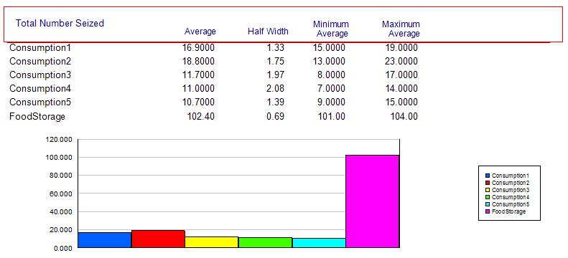
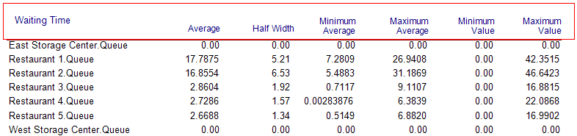
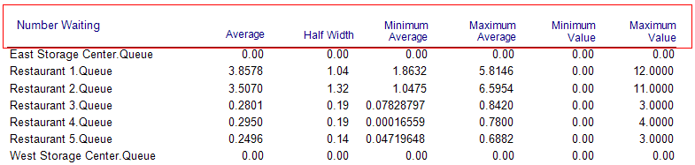
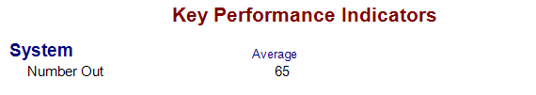
Simulation Results
Total number out (number of foods disposed) (Figure a)
Total number of resources seized (Figure b)
Queue waiting time (Figure c)
Queue number waiting (Figure d)
Figure b. Resource - Total Number Seized
Figure d. Queue – Number Waiting
Figure a. KPI
Figure c. Queue – Waiting Time

Slide 7
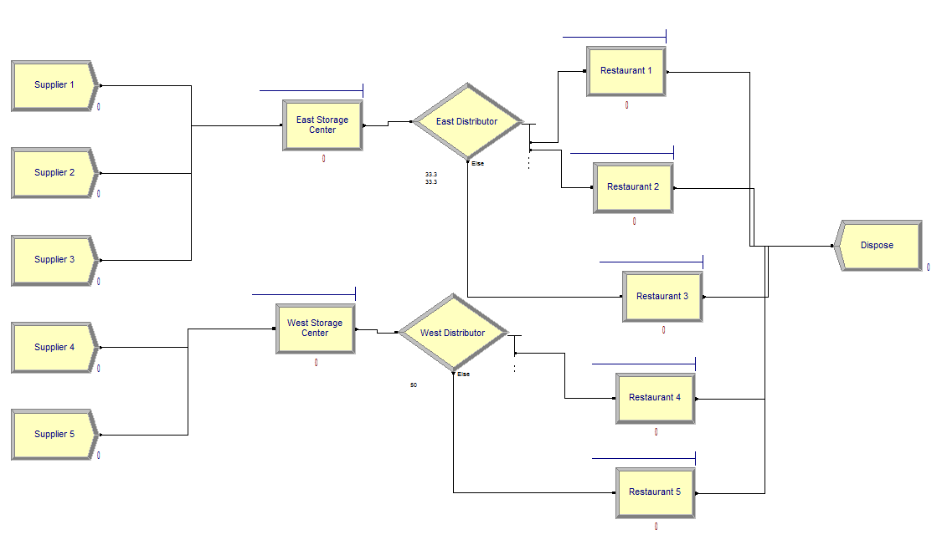
Comparison and Optimization (1)
The main bottle neck on the east side where the processing power of two restaurants cannot keep up with the speed of the entity produced and distributed to them, hence cause long wait time in queue.
One possible solution is to make East Distributor distribute to restaurant 3 and leave only restaurant 4 and 5 to West Distributor.
Figure 3. The re-balanced flowchart

Slide 8
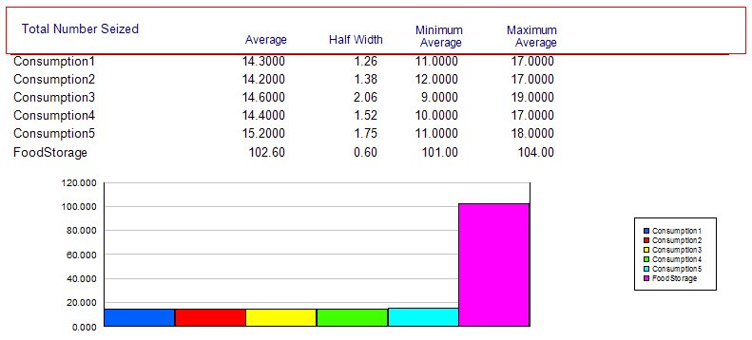
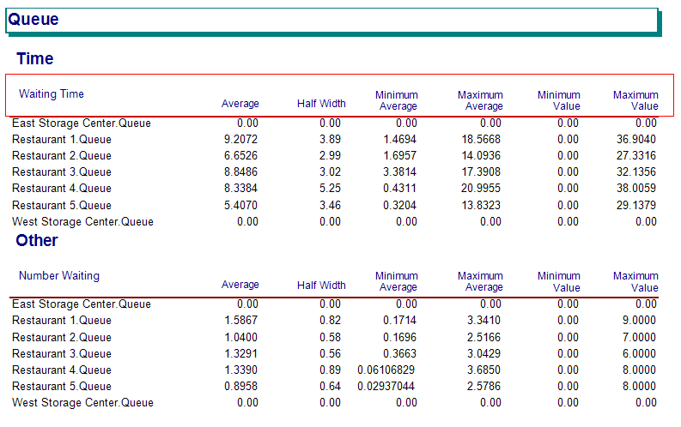

Simulation Results
Figure e. Resource – Total Number Seized
(re-balanced)
Figure e and f shows more balanced usage of restaurant resources and queue wait time.
However, the overall processing power of the system does not increase. KPI remains approximately the same.
Figure f. Queue Time (re-balanced)
Figure g. KPI (re-balanced)

Slide 9
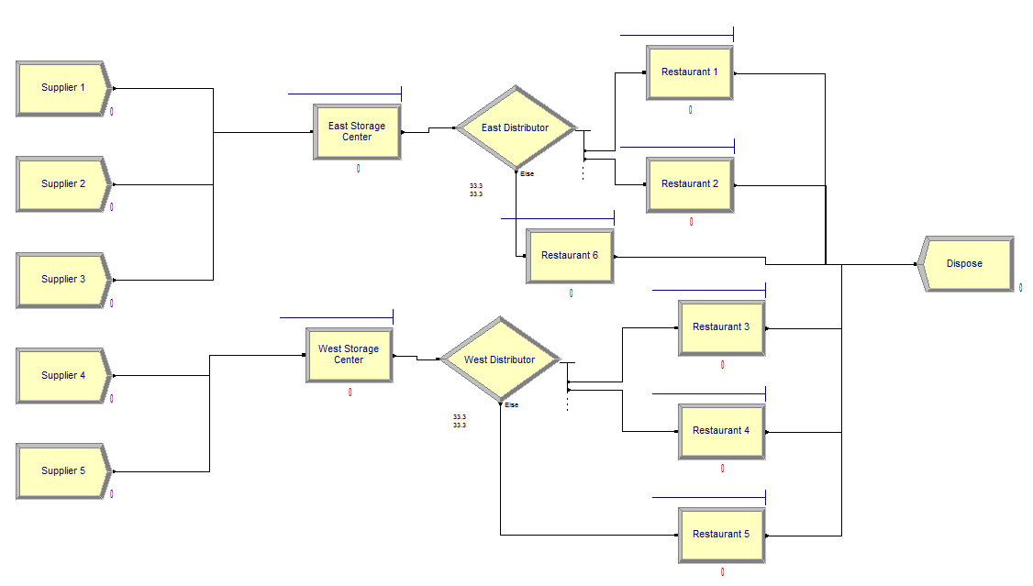
Comparison and Optimization (2)
To increase the overall processing power of the system and balance the resource usage, we add extra processing unit to the system, by opening one more restaurant on the east side.
Figure 4. The flowchart (Extra Restaurant)

Slide 10
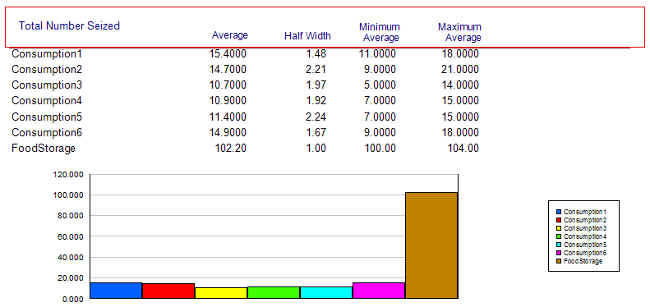

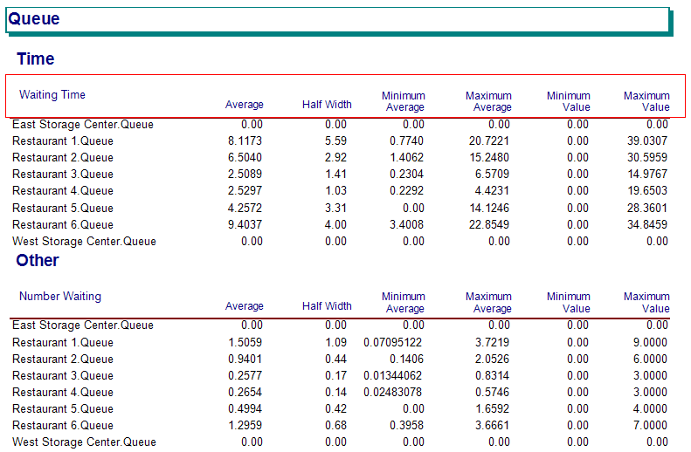
Simulation Results
The overall processing power increases, indicated by a larger KPI as Figure h.
Balanced usage of resources and queue wait time as Figure i and j.
Figure h. KPI (extra restaurant)
Figure i. Resource – Total Number Seized (extra restaurant)
Figure j. Queue Time (extra restaurant)

Slide 11
Conclusion and Main Findings
Through modelling simulation in ARENA, the main bottle neck was identified, and possible solutions were proposed and simulated.
The simulation indicates more balanced usage of resources and queue waiting time. The researcher proposed to add extra processing unit to the system to increase the overall processing power of the system and balance the resource usage.
The cost of adding extra processing unit is compared. The cost-benefit balance should be considered when making decisions during processes of food supply chain management.

